Slide 1
3. Planning of activities considering the team's production capacity: creation of a backlog
(11.5 hours)

Slide 2
Summary
3.1 How to create a backlog (2.5 hours)
3.2 How to manage card granularity (2.5 hours)
3.3 How to manage capacity planning (2.5 hours)
3.4 Practical workshop - Agile adoption: building a board and writing cards (4 hours)

Slide 3
3.1 How to create a backlog (2.5 hours)

Slide 4
What is a backlog?
A prioritized list of features, enhancements, bug fixes, tasks, etc.
Owned and maintained by the Product Owner
Evolving document – it is never complete
Provides a single source of requirements for any changes to be made to the product

Slide 5
Components of a backlog item
Title – Brief summary
Description – Detailed explanation or user story
Acceptance Criteria – Conditions to consider the story “done.”
Priority – Order of importance
Estimation – Effort required (e.g., story points, hours)

Slide 6
How to create a backlog
TIP: You choose the granularity of the cards on your board. You can decide what is an 'Epic' and what is a 'Story’.
Example:
SCOPE OF WORK: tender
EPIC: Technical documentation; Economic documentation; Administrative documentation
STORY: Completion of documents; Drafting of estimates
TASK: Completing Annex 1 and Annex 2, Creating economic simulation files

Slide 7
How to create a backlog
SCOPE OF WORK
EPIC 1
EPIC 2
EPIC 3
USER STORY 1.2
USER STORY 1.2
USER STORY 2.1
TASK 2.1.1
TASK 2.1.2
TASK 2.1.3

Slide 8
How to create a backlog
Start with high-level goals - What problems are we solving?
Write user stories – Use the format: “As a [user], I want [feature] so that [benefit].”
Break down epics into smaller stories.
Prioritize based on business value and urgency.
Estimate effort with the team.
Review and refine regularly (Backlog Grooming/Refinement).

Slide 9
How to create a backlog - Common mistakes to avoid
Having vague or overly detailed stories
Not involving the team in backlog refinement
Ignoring technical debt or bugs
Letting the backlog grow without pruning

Slide 10
Group Exercise – Create a mini product backlog
Scenario: EduTrack is an initiative to create a web-based classroom management platform designed to simplify administrative tasks for teachers, improve student engagement, and provide real-time insights into academic progress.
The platform includes features like attendance tracking, assignment submissions, grade management, and student-teacher communication.
The web solution must be intuitive, scalable, and secure, focusing on user-friendly design and continuous adaptability through iterative feedback from teachers and students.

Slide 11
Group Exercise – Create a mini product backlog
Exercise: Think of 5 features or needs students/teachers might have.
Instructions:
In small groups, write 5 user stories using the format: “As a [student, teachers], I want [feature] so that [benefit].”
Assign a priority (1–5) and a rough estimate (e.g., 1–3 points).
Present your mini backlog to the class.
Example:
As a student, I want to create a to-do list so that I can track my assignments. Priority: 1 – Estimate: 2 points

Slide 12
How to create a backlog
At the beginning, building the backlog will be very difficult!
Sometimes you build cards that are too 'big' (you realise this when a card remains in the 'doing' state for too long)…
…other times you go into too much detail (you can tell if a card transits the board for too short a time)
Tip: divide the cards so that they never last more than 4 hours, i.e. half the working day. You will move more cards and be more motivated!
To what extent should the content of the cards be detailed?

Slide 13
3.2 How to manage card granularity (2.5 hours)

Slide 14
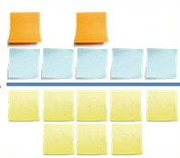

Different granularities
SCOPE OF WORK
SCOPE OF WORK
EPICS
USER STORIES
USER STORIES
TASKS
TASKS
WHAT ENDS UP IN THE ‘BACKLOG’ COLUMN OF THE BOARD

Slide 15
WBS vs RBS
REQUIREMENTS / FEATURE BREAKDOWN STRUCTURE
(Agile)
WORK BREAKDOWN STRUCTURE
(Waterfall)
Breakdown of the project from the WORK to be performed
Breakdown of the project from REQUIREMENTS / FEATURES
of the OUTPUT

Slide 16
WBS vs RBS
REQUIREMENTS / FEATURE BREAKDOWN STRUCTURE
(Agile)
WORK BREAKDOWN STRUCTURE
(Waterfall)
Scope of work
Task 1.1.1
Phase 1
Task 1.1
Task 1.2
Task 2.1
Task 2.2
Task 3.1
Task 3.2
User Story 1.1
Epic 1
Task 1.1.2
Phase 2
User Story 1.2
Scope of work (vision)
User Story 2.1
Phase 3
Epic 2
Task 2.2.1
User Story 2.2
Task 2.2.2
21

Slide 17
Feature vs Epic
Feature: describes a solution and/or answer to a given requirement
Epic: large body of work that can be broken down into a series of smaller stories

Slide 18
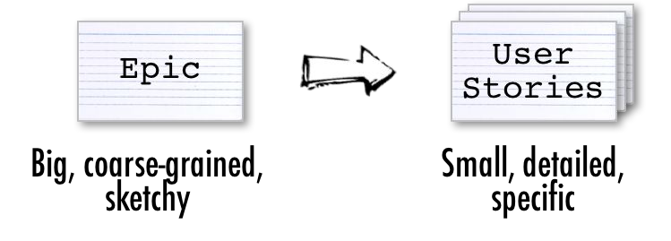
Epic vs User Story

Slide 19
Epic vs User Story
Each Epic is an expression of a requirement and is very similar to a story (but bigger and more complex)...
...and serves to structure and group requirements to better manage the backlog.
User Story: the most efficient way of defining expectations about new functionalities and/or improvements regarding a certain output

Slide 20
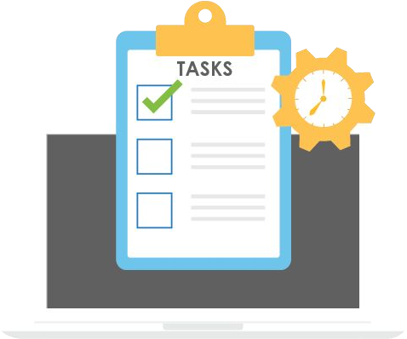
Task
Task: a unit of work needed to realise a user story

Slide 21
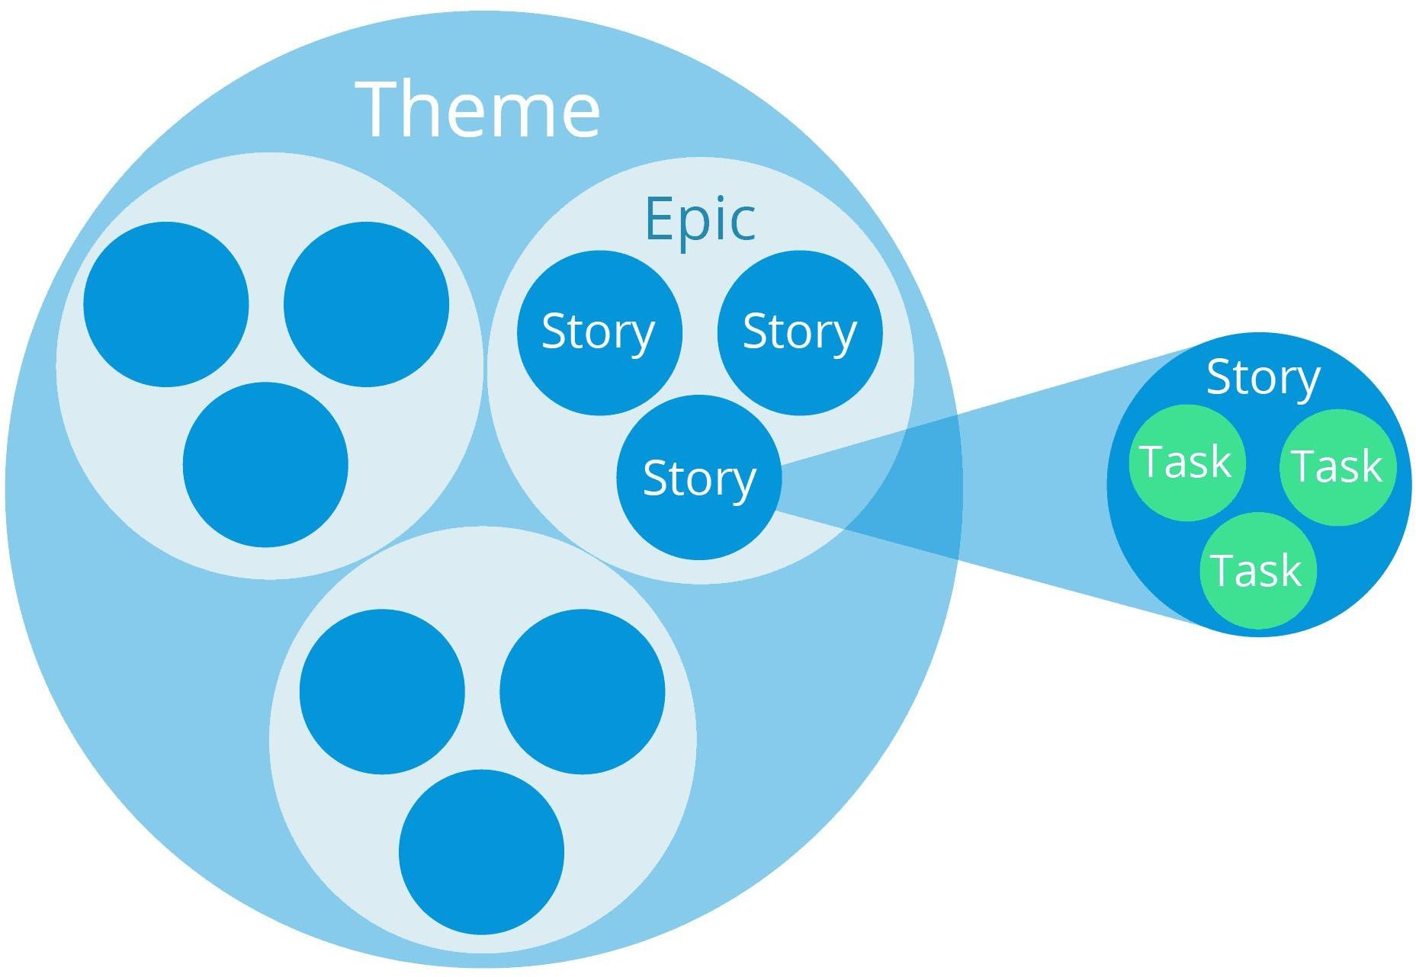
Relations between different cards

Slide 22
Three good reasons to use RBS
Allows the team and the client to communicate using mutually understandable terms
Allows prioritisation of work based on the customer's perceived value
Keeps track of work against actual value produced

Slide 23
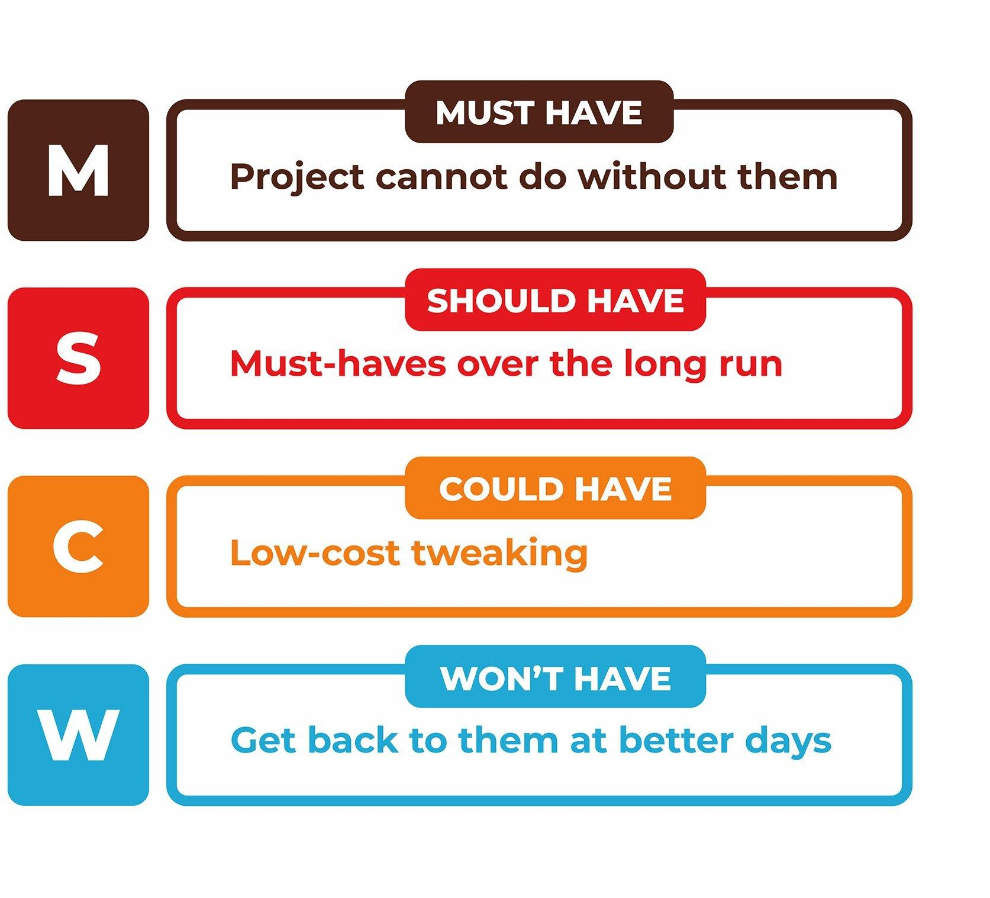
Moscow Method

Slide 24
How to create a backlog - Tips
When creating backlogs, start with the largest features and then break them down over time
This allows the customer not to go into detail until it is really necessary

Slide 25
Distinguishing cards
The simplest and most direct method is to create and use 'labels’ to distinguish cards already in the creation phase.
There are also power-apps useful for this purpose. One of these is Screenful for Trello. How does it work?

Slide 26
Epic Cards by Screenful
Screenful's Epic allows you to:
Indicate which lists contain epic
E.g.: we might decide that in the backlog we put all cards of type "Epic“
2) Assigning tasks to each epic NB: First I have to create the task (e.g. in To Do) and then assign it to the Epic in the backlog

Slide 27
Epic Cards by Screenful
3) Defining a syntetich version of the RBS
This makes it possible to observe the number of tasks per epic (≈ RBS) and monitor progress for each epic.

Slide 28
3.3 How to manage capacity planning (2.5 hours)

Slide 29
Managing capacity planning
Our normal customer demands the maximum in the shortest possible time, with the twofold result
Capacity saturation
Complex releases
Factors that very often result in:
Frustrated teams
Increasing time to market

Slide 30
Managing capacity planning
So what to do?
Giving weight to outcomes
Define a release plan

Slide 31
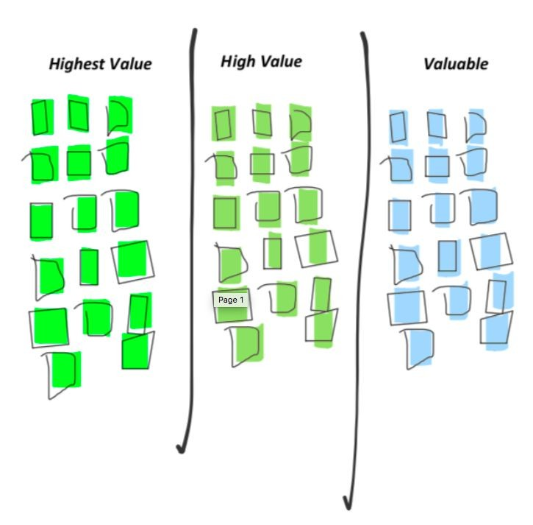

Giving weight to outcomes
How important are features (CARDs) to each other?
Which of them are most likely to achieve the desired OUTCOME value?

Slide 32
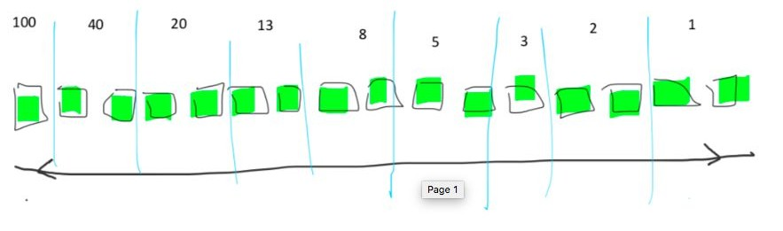
Giving weight to outcomes
How much do the most important features weigh individually?
Note: let the team make the estimates!

Slide 33
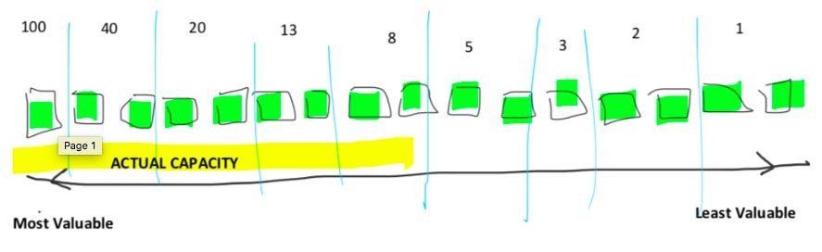
Giving weight to outcomes
What is the actual production capacity available?

Slide 34
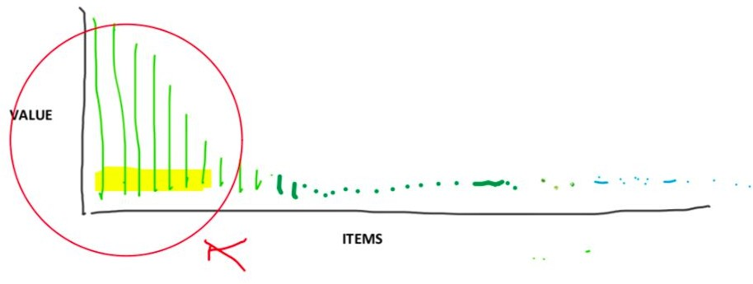
Giving weight to outcomes
And with a Pareto diagram [representation of the degree of influence of certain variables on a phenomenon] we get that...

Slide 35
Establishing a release plan
Release Plan: set of activities aimed at transforming requests into tested and functioning outputs
How to proportion the backlog according to the team's production capacity?
Capacity planning: optimising productivity by managing available resources and skills needed for the Sprint

Slide 36
Establishing a release plan
Example: a team of 6 people is asked to complete a series of activities estimated at 200 hours in 5 days
Activity weight: 200h
Sprint duration: 5 days
Duration of working day: 8h
Team size: 6 persons
Total working capacity: 5*8*6 = 240h
But why then do we often end up in overload?

Slide 37
Establishing a release plan
Some of the factors limiting capacity:
Uneven teams (different skills)
Several projects at the same time
Bottlenecks (e.g. validation)
Emerging activities (tickets)
So what to do?

Slide 38
Establishing a release plan
Some of the factors limiting capacity:
Uneven teams (different skills)
Several projects at the same time
Bottlenecks (e.g. validation)
Emerging activities (tickets)

Slide 39
Establishing a release plan
So what to do?
Define the team configuration in advance
Limiting the number od open contexts
Foresee validation times
Establishing a Focus Factor

Slide 40
Focus Factor (FF)
Focus Factor (FF): estimation of how focused the team is.
Average = 70%
A lower FF may mean that the team anticipates many disturbing factors or assumes that they have made over-optimistic estimates.
How to calculate a reasonable Focus Factor
The best way is based on the performance of the last sprint (or the average of the most recent sprints)?

Slide 41
Focus Factor (FF)
Calculation of the Focus Factor
FFof the last sprint = Effective speed/Available man days
Effective speed: Sum of the weight of all stories completed in the last sprint.
Once the weight of the cards and the focus factor have been defined, we can define the Release Plan.

Slide 42
Exercise
Activity weight: 200h
Sprint duration: 5 days
Duration of working day: 8h
Team size: 6 persons
Focus Factor: 0.7
What is the effective working capacity?

Slide 43
What have we learnt?
Renegotiating EFFORT based on the SHARED UNDERSTANDING of VALUE (outcome-oriented) and according to the PRODUCTIVITY OF THE TEAM
Assess the EFFECTIVE IMPACT of any ADDITIONAL RESOURCES
Give PRIORITY to the backlog through a COHERENT RELEASE PLAN
Understand if and when to add any EMERGING FEATURES to the backlog

Slide 44
What have we learnt?
Renegotiating EFFORT based on the SHARED UNDERSTANDING of VALUE (outcome-oriented) and according to the PRODUCTIVITY OF THE TEAM
Assess the EFFECTIVE IMPACT of any ADDITIONAL RESOURCES
Give PRIORITY to the backlog through a COHERENT RELEASE PLAN
Understand if and when to add any EMERGING FEATURES to the backlog

Slide 45
2.5 Practical workshop - Agile adoption: building a board and writing cards (4 hours)

Slide 46
Practical workshop
Scenario: EduTrack is an initiative to create a web-based classroom management platform designed to simplify administrative tasks for teachers, improve student engagement, and provide real-time insights into academic progress.
The platform includes features like attendance tracking, assignment submissions, grade management, and student-teacher communication.
The web solution must be intuitive, scalable, and secure, focusing on user-friendly design and continuous adaptability through iterative feedback from teachers and students.

Slide 47
Practical workshop
Exercise: Now you’re ready to try to set up an Agile board!
Based on the EduTrack scenario:
Define workflows
Write user stories and tasks on cards
Manage work effectively
NOTE: you can do this either in physical form, using paper sheets and markers, or in digital form (recommended option), using the Miro board found here.

